Slide 1
RL Based Thermal Comfort Controller
Progress Presentation

Slide 2

Reward Functions
In that case, the heating set point is used to define the [LT, UT] flexibility band of temperature. In this work, we used 68 ◦F and 74 ◦F as heating and cooling set points, respectively:
Kurte, K.; Munk, J.; Kotevska, O.; Amasyali, K.; Smith, R.; McKee, E.; Du, Y.; Cui, B.; Kuruganti, T.; Zandi, H. Evaluating the Adaptability of Reinforcement Learning Based HVAC Control for Residential Houses. Sustainability 2020, 12, 7727. https://doi.org/10.3390/su12187727

Slide 3
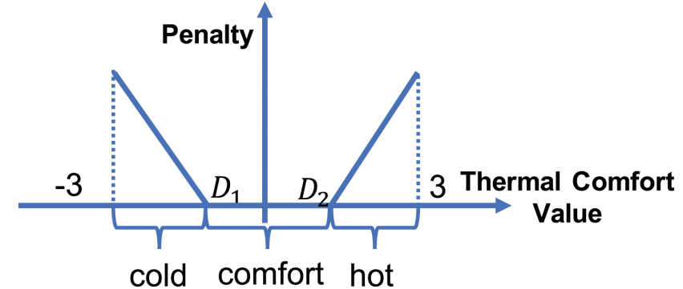

Reward Functions
Penalty on thermal comfort. If the thermal comfort value is less than D1, the occupants will feel too cold. If it is larger than D2, the occupants will feel too hot. [D1, D2] is the comfort zone
G. Gao, J. Li and Y. Wen, "DeepComfort: Energy-Efficient Thermal Comfort Control in Buildings Via Reinforcement Learning," in IEEE Internet of Things Journal, vol. 7, no. 9, pp. 8472-8484, Sept. 2020, doi: 10.1109/JIOT.2020.2992117.

Slide 4
Reward Functions
H is presence or absence of person. C is energy consumption. Alpha and theeta/phi represents the importance of energy
Liang Yu, Zhanbo Xu, Tengfei Zhang, Xiaohong Guan, Dong Yue,
Energy-efficient personalized thermal comfort control in office buildings based on multi-agent deep reinforcement learning,
Building and Environment,Volume 223,2022,109458,ISSN 0360-1323,
https://doi.org/10.1016/j.buildenv.2022.109458.

Slide 5
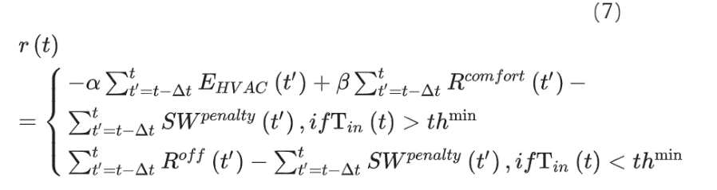
Reward Functions
sw is penality for switching
ED-DQN: An event-driven deep reinforcement learning control method for multi-zone residential buildings

Slide 6


Reward Functions
the first term is the energy cost of the HVAC system, where λretail(t’) is the retail price, EHAVC(t’) is the power consumption, and Δt is the control interval; the second term is the penalty for user comfort violation, which is calculated as follows:
Tth is a threshold with a small value. The temperature violation is not counted if the magnitude of the violation is smaller than Tth.
Intelligent multi-zone residential HVAC control strategy based on deep reinforcement learning

Slide 7
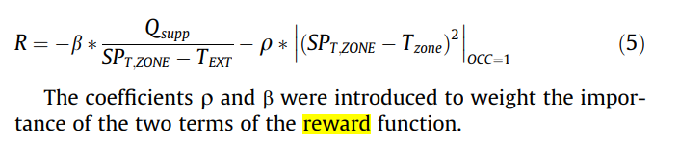
Reward Functions
Deep reinforcement learning to optimise indoor temperature control and heating energy consumption in buildings

Slide 8

Reward Functions
where CLsystem is the system cooling load (kW), Pchillers is the total power of all chillers (kW), Pcwps is the total power of all cooling water pumps (kW), and Ptowers is the total power of all cooling towers (kW). The goal is to make this reward value as large as possible, i.e., the sum of the powers in the denominator is small, which means that energy savings are achieved.
Applications of reinforcement learning for building energy efficiency control: A review 1 Qiming Fu Journal of Building Engineering ELSEVIER 2022

Slide 9
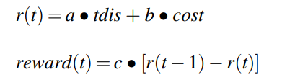
Reward Functions
where r(t) represents the performance of operation cost and zone temperature at t time; reward(t) represents the value of reward given to the agent at t time; a, b, c are weight factors, which are set to 10, 1, 0.05, respectively.
Comparative study of model-based and model-free reinforcement learning control performance in HVAC systems 1 Cheng Gao Journal of Building Engineering ELSEVIER 2023

Slide 10
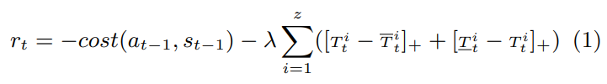
Reward Functions
which includes the energy cost of the last control action at t−1 and the total penalty of temperature violation
Deep Reinforcement Learning for Building HVAC Control 0 Tianshu Wei University of California, acm

Slide 11
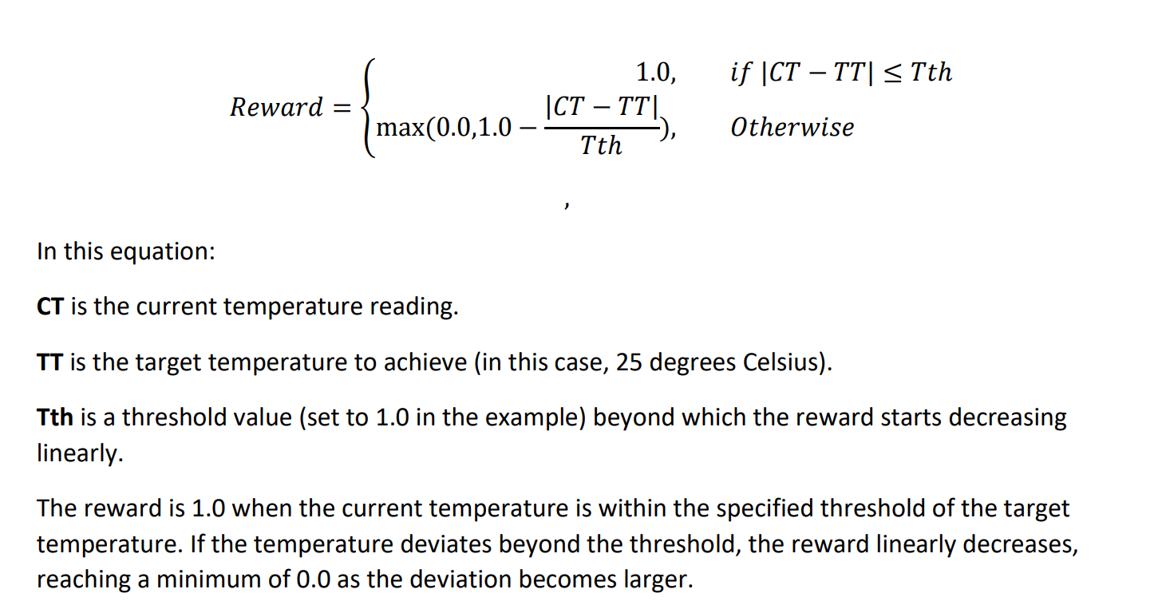
My versions

Slide 12
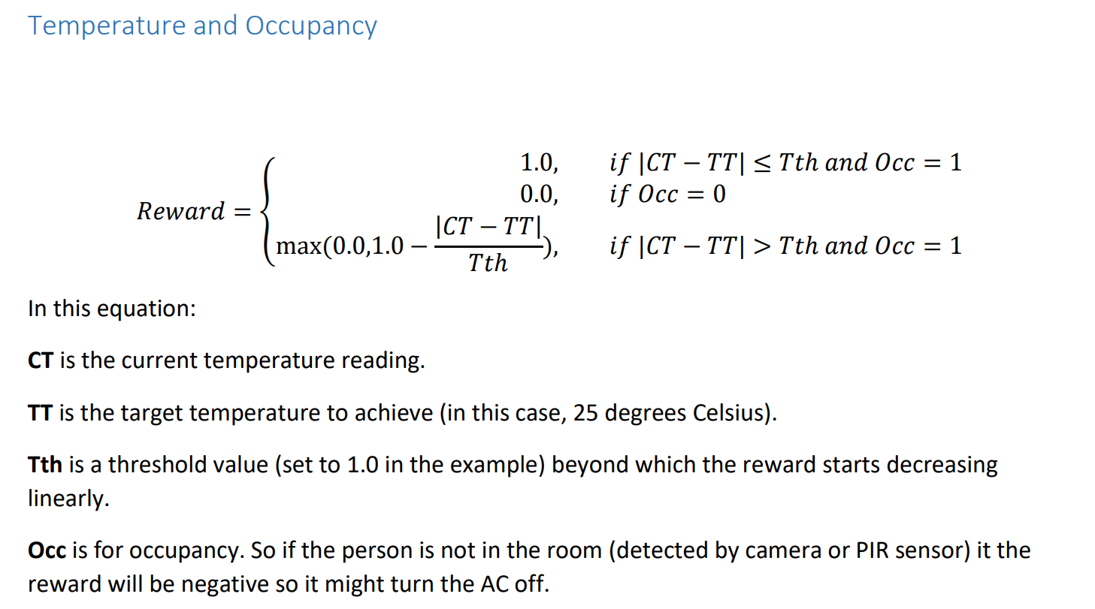
My versions

Slide 13
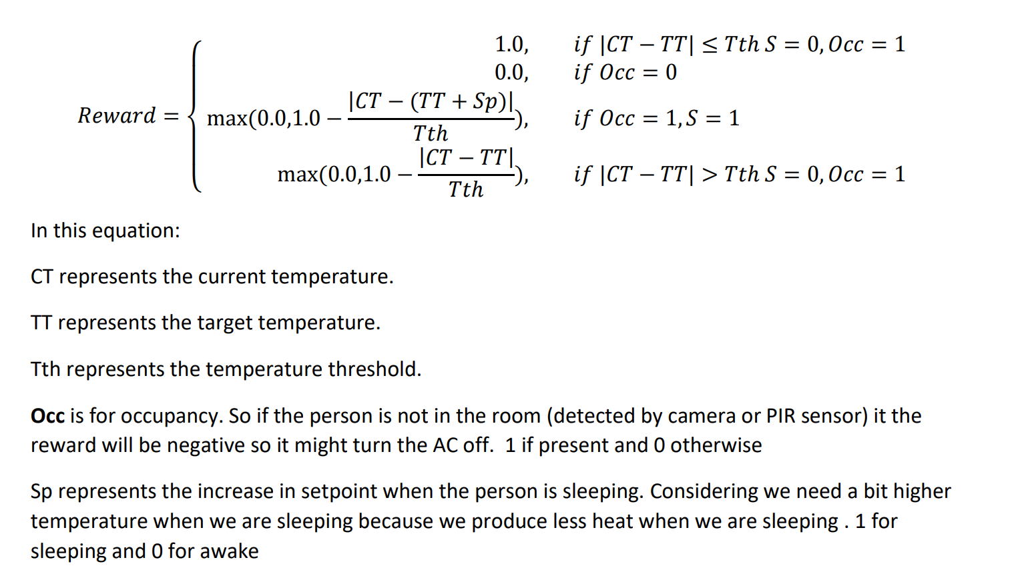
My versions
Temperature, Occupancy and Sleeping patterns

Slide 14
My versions
Temperature, Occupancy and Sleeping patterns

Slide 15
Simulators
Simulator used
Building Control Virtual Test Bed (BCVTB) and the external interface of EnergyPlus to perform the simulations
Electrical Thermal model as in 7
Energy Plus
Energy Plus
Energy Plus, ASHRAE9012016_OfficeSmall_Denver
IDA ICE
NA
new simulation environment, merged by the building energy simulator CitySim and the machine learning library TensorFlow
open-source testbed for building control performance benchmarking, building optimization testing framework (BOPTEST) [32] is selected as the virtual test environment in this paper.The test case “BESTEST Hydronic Heat Pump” is of interest in this paper. This model represents a simplified residential dwelling for a 5-member family, modeled as a single thermal zone, located in Brussels, Belgium. The building has a rectangular floor plan of 12 m by 16 m and contains 24 m2 of windows on the south facade.
simulation testbed using Python
TRNSYS & Matlab
Mainly Energy Plus with Gym

Slide 16
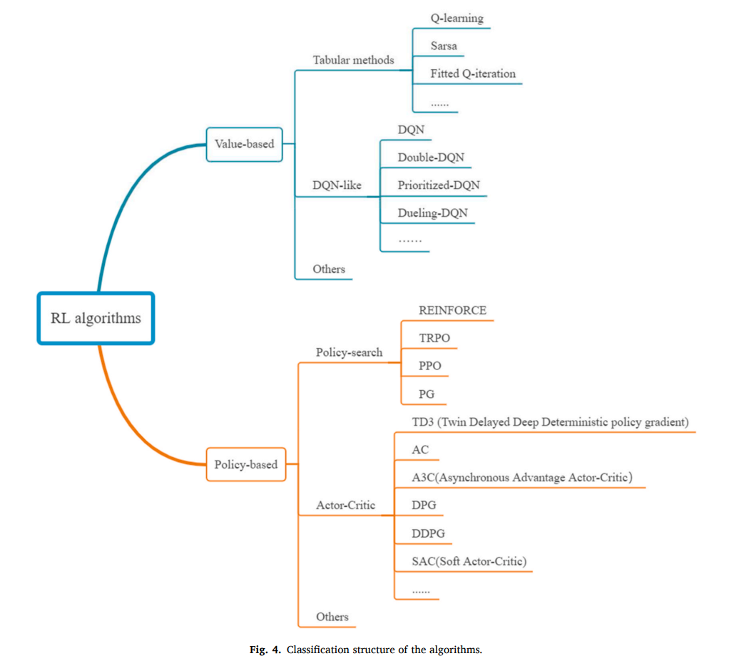
What Algorithm do you suggest?

Slide 17


Slide 18
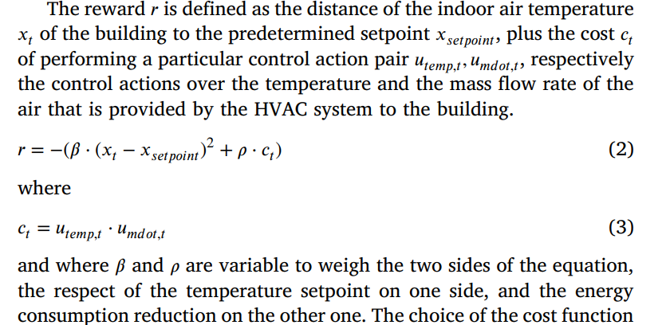

Slide 19
Available Gits
Sr | Name | Link
1 | Reinforcement Learning with Gym | Learn by example Reinforcement Learning with Gym | Kaggle
2 | Reinforcement Learning baseline in Python | Reinforcement Learning baseline in Python | Kaggle
3 | Heating system control with Reinforcement Learning | GitHub - tilkb/thermoAI: Heating system control with Reinforcement Learning
4 | DDPG vs PID | GitHub - akmenon1996/TemperatureControl-ReinforcementLearning: Comparing the performance of a DDPG Reinforcement learning model to control temperature with that of a PID and a thermostat controller.
5 | Energy-Efficient Thermal Comfort Control in Smart Buildings via Deep Reinforcement Learning | GitHub - arunajit/drl: Implementation of Research paper, Deep reinforcement learning based framework for energy optimization and thermal comfort control in smart buildings
6 | Model-based Reinforcement Learning for Building HVAC Control | GitHub - vermouth1992/mbrl-hvac: Model-based Reinforcement Learning for Building HVAC Control
7 | A Reinforcement Learning solution for HVAC control to optimize energy consumption. Developed by Vector Institute and TELUS. | GitHub - VectorInstitute/HV-Ai-C: A Reinforcement Learning solution for HVAC control to optimize energy consumption. Developed by Vector Institute and TELUS.
8 | Deep Reinforcement Learning AI Approach to Control HVAC Systems | GitHub - qatshana/Cool.AI: Deep Reinforcement Learning AI Approach to Control HVAC Systems
9 | PI Controller vs Reinforcement Learning to control temperature inside a room | GitHub - NasimKaveh/Thermal-HVAC-model: PI Controller vs Reinforcement Learning to control temperature inside a room
10 | A precocial reinforcement learning solution for HVAC control | GitHub - INFERLab/Gnu-RL: A precocial reinforcement learning solution for HVAC control
11 | System that learns how often a room is occupied based on time, movement, air conditioning preferences and learns on historic data. | GitHub - faisalthaheem/machine-learnt-air-conditioning: System that learns how often a room is occupied based on time, movement, air conditioning preferences and learns on historic data. This can have a significant impact on the energy use around a house/building.
12 | Using Reinforcement Learning to control HVAC for efficient use of energy | GitHub - arowdy98/RL-for-HVAC-control: Using Reinforcement Learning to control HVAC for efficient use of energy

Slide 20
Queries
Should we only consider temperature and power consumption?
Data sleeping patterns and Occupancy
Model based or Model Free?
Data based only?
Do you suggest any house dataset and almost everybody else is working on buildings dataset

Slide 21
